Slide 1

The Seller Next Door

Slide 2
Our Topic
Reason for choosing
Questions to be answered with our analysis

Slide 3
Source of Data
Postgres database that consists of two tables of Los Angeles Real Estate data.
Sales Table
45 Columns
6829 Rows
Total Table
52 Columns
39310

Slide 4
Data Exploration and Processing
Data Exploration:
SVM was not particularly helpful in classifying the data, which we believe was caused by the large number of categorical variables in the dataset. because of the number of categorical variables. The SVM results in a model with high accuracy score but low precision.
The large number of categorical variables means that it is difficult to visually observe group distinctions using logistic regression or SVM.

Slide 5
Data processing:
One of the major challenges for our model is to properly divide the data into training and testing sets. The nature of real estates means that their sales frequency and success rate of sales are much lower than typical commodities. Therefore, there is a disproportional amount of data in the “not sold” bracket, causing a high accuracy but low probability in the predicted result.
Hence, we will be using decision trees and random forests to exploit the binomial variables.

Slide 6
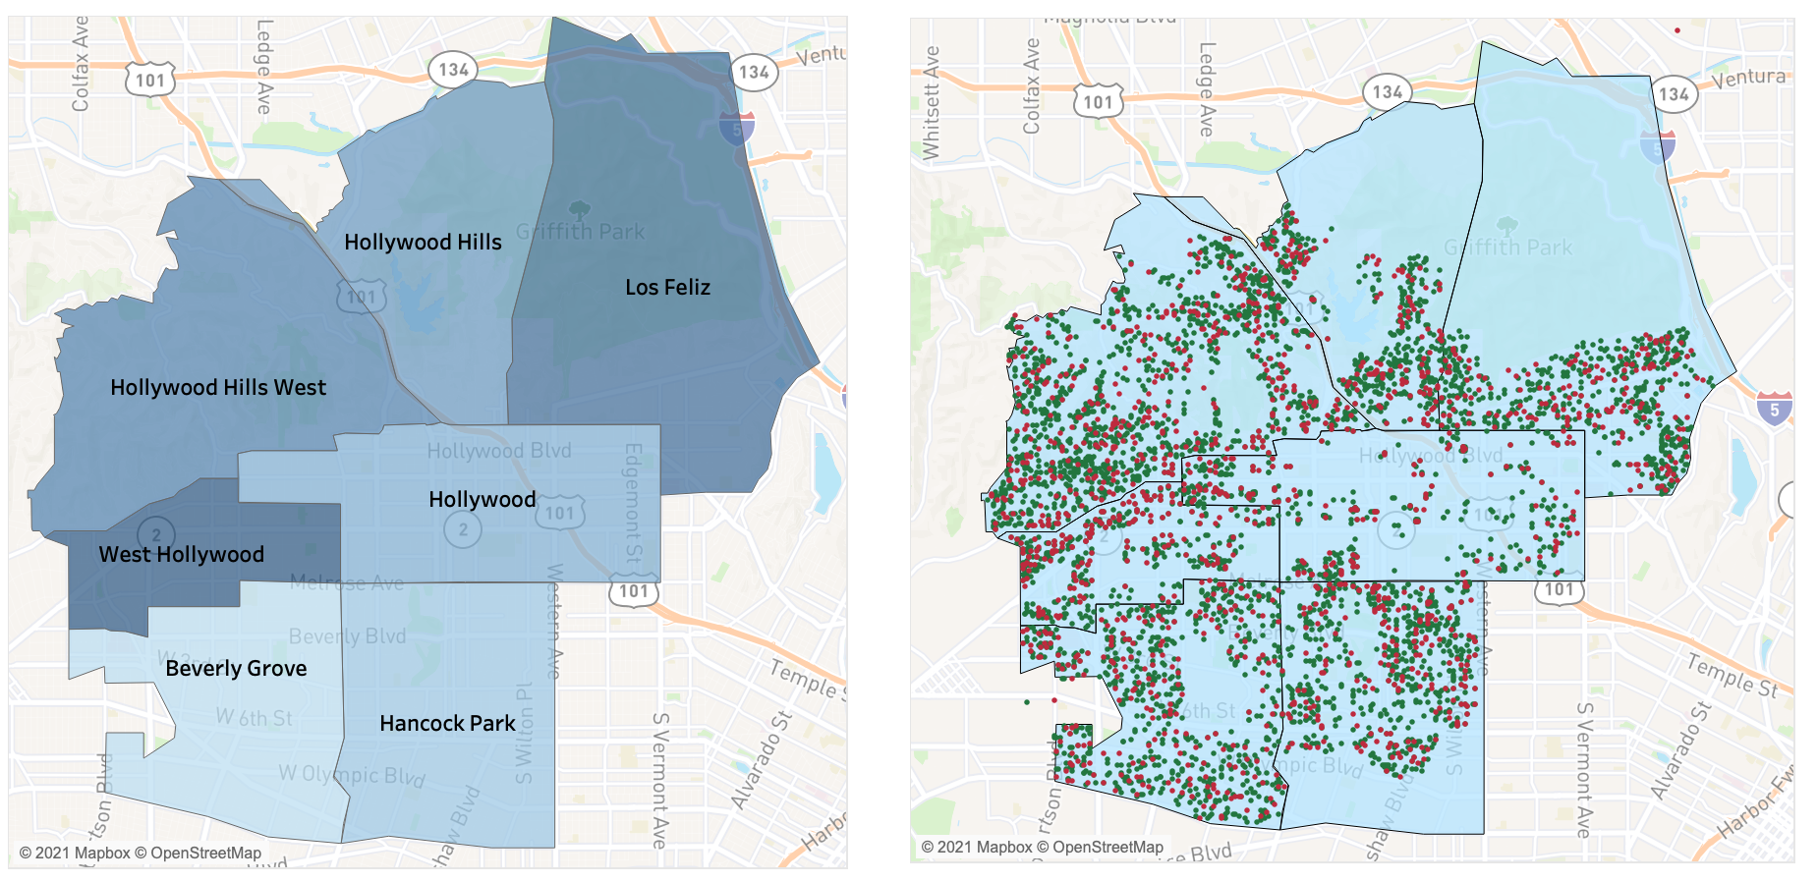
Storyboard
Neighborhood Map
The map will color each neighborhood to show the accuracy of the machine learning model in predicting house sales. If house and condo sales show a different short they will be split into individual maps.
Not actual model outcome data

Slide 7
Storyboard
Sale Prediction Outcome
Each house sold will be mapped and colored according to whether the model accurately predicted the sale.
Not actual model outcome data

Slide 8
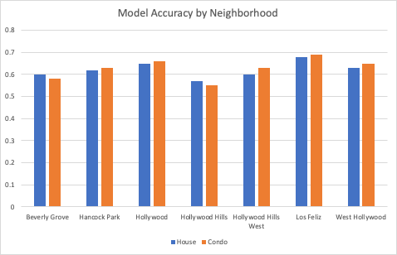
Storyboard
A chart will show the model outcome accuracy (and/or other statistical metrics) for each neighborhood and house type.
Not actual model outcome data

Slide 9
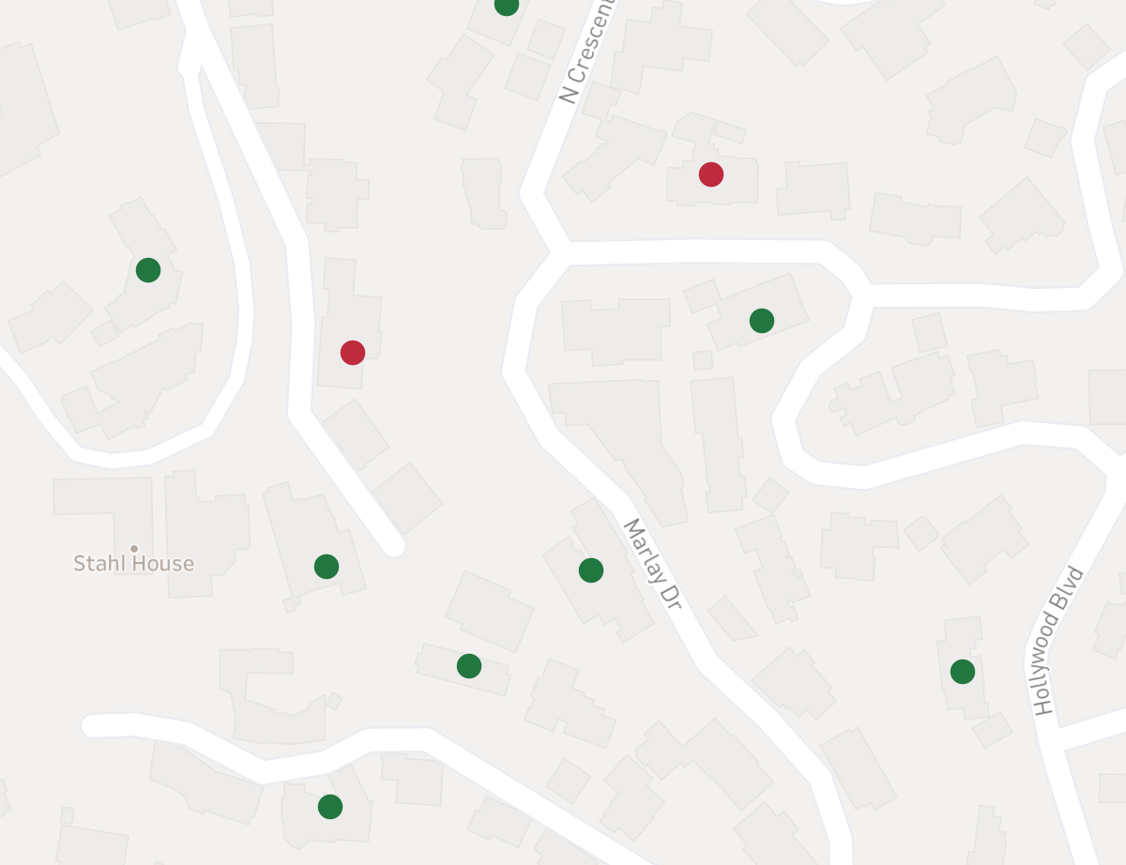
Storyboard
Example of how this model can be used going forward to understand the likelihood of a property selling that was not included in the model.
e.g. What are the cances that 1663 Marlay Dr. will sell?
Not actual model outcome data

